Slide 1
Chapter 16
Statistical Tests
Chi-Square Test
Bartlett’s Test
Mann’s test
Kolmogorov-Smirnov Test
Tests for the Power-Law Process Model
Chapter 16
Notes:
In the previous Chapter, procedures for identifying candidate failure or repair distributions were discussed along with methods for estimating their parameters. The paradigm is completed with the introduction of statistical tests of the hypothesis that these failure (repair) times came from a specified distribution. Such tests are referred to as goodness-of-fit tests.

Slide 2
Hypothesis Testing
H₀: The failure times came from the specified distribution.
H₁: The failure times did not come from the specified distribution.
H₀ true H₁ true
Accept H₀ correct Type II
decision error
Accept H₁ Type I correct
error decision
Chapter 16
Notes:
Like any statistical hypothesis tests, the decision to accept or not accept the null hypothesis is based upon controlling the probability of making an error. Specifically, the probability of making a Type I error is often specified and is referred to as the level of significance of the test.

Slide 3
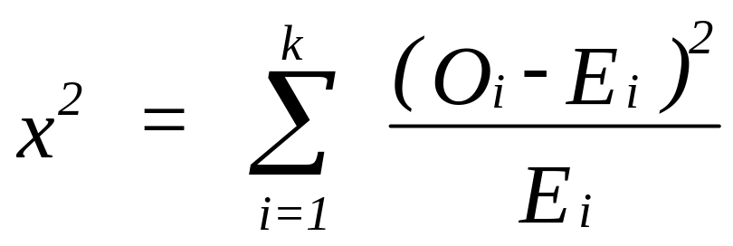
Chi-Square GOF Test
with df = k - 1 - number
of estimated parameters
where k = number of classes
O_{i} = observed number of failures in the i^{th} class
E_{i} = expected number of failures in the i^{th} class
= n p_{i}
n = total number at risk (sample size)
p_{i} = F(a_{i}) - F(a_{i-1}) = R(a_{i-1}) - R(a_{i})
probability of a failure occurring in the i^{th} class if H₀ is true
Hypothesized
distribution
i^{th} class is defined by [a_{i-1} , a_{i}) with a₀ = 0
Chapter 16
Notes:
Presented in this chapter is a general GOF test based upon the Chi-square probability distribution and specific tests designed for fitting the exponential, Weibull, normal, and lognormal. To generate the Chi-square statistic, the number of failures falling into the i^{th} time interval is determined (O_{i}). This number is compared to the expected number (E_{i}) of failures if the null hypothesis is correct. The degrees of freedom is the parameter of the Chi-square statistic. It is found by adding the number of classes or cells and then subtracting one plus the number of estimated parameters from this total.

Slide 4
Chi-Square GOF Test - Repair
with df = k - 1 - number
of estimated parameters
where k = number of classes
O_{i} = observed number of repairs in the i^{th} class
E_{i} = expected number of repairs in the i^{th} class
= n p_{i}
n = total number at risk (sample size)
p_{i} = H(a_{i}) - H(a_{i-1})
probability of a failure occurring in the i^{th} class if H₀ is true
Hypothesized
distribution
Chapter 16
Notes:
Presented in this chapter is a general GOF test based upon the Chi-square probability distribution and specific tests designed for fitting the exponential, Weibull, normal, and lognormal. To generate the Chi-square statistic, the number of failures falling into the i^{th} time interval is determined (O_{i}). This number is compared to the expected number (E_{i}) of failures if the null hypothesis is correct. The degrees of freedom is the parameter of the Chi-square statistic. It is found by adding the number of classes or cells and then subtracting one plus the number of estimated parameters from this total.

Slide 5

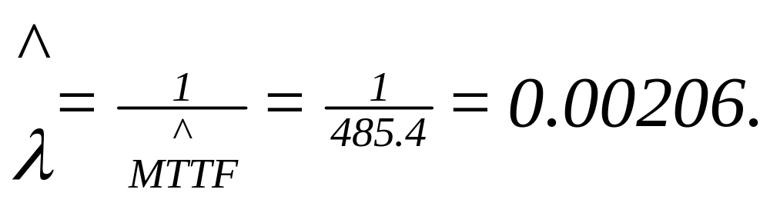
Example - Exponential Distribution
35 failure times are grouped into the 6 cells as shown:
Cell Upper bound Count
1 354 18
2 688 10
3 1022 2
4 1356 2
5 1690 2
6 2026 1
Expected cell counts >=5
MLE:
Chapter 16
Notes:
The statistic computed has an approximate Chi-square distribution. For this to be a good approximation, a rule of thumb is that the expected cell (interval) count be equal to at least 5. In order to meet this criterion, it is common practice to combine 2 or more cells.

Slide 6
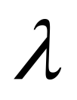
Example - Exponential Distribution
H₀: Failure times are exponential with =0.00206
H₁: Failure times are not exponential with =0.00206
E₁ = 35 P₁ = 35 [ 1 - e^{-354/485.4} ] = 18.120
E₁ = 35 P₂ = 35 [ 1 - e^{-688/485.4} - P₁ ] = 8.396
E₃ = 35 P₃ = 35 [ 1 - P1 - P2 ] = 8.483
Chapter 16
Notes:
The expected cells are computed based upon the hypothesized distribution. The parameters of the distribution are estimated using the MLE computed from the sample. In fact, because the sample is being used to estimate the parameters, one degree of freedom is lost for each parameter estimated.

Slide 7
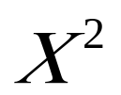
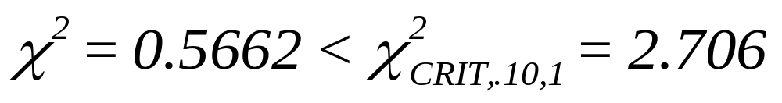
Example - Exponential Distribution
UPPER BND OBSERVED PROB EXPECTED (O-E)²/E
354 18 .5177247 18.12036 7.994791E-04
688 10 .239903 8.396606 .3061798
INFINITY 7 .2423723 8.483031 .2592684
= .5662476
df = 3 - 1 - 1 = 1
Cannot reject H₀ at 10% level
Chapter 16
Notes:
With several cells combined, a Chi-square statistic is computed and compared to a table value based upon the degrees of freedom and the specified level of significance.

Slide 8
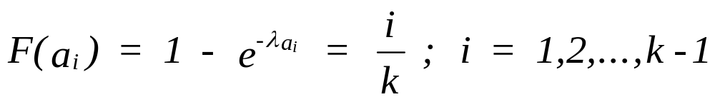
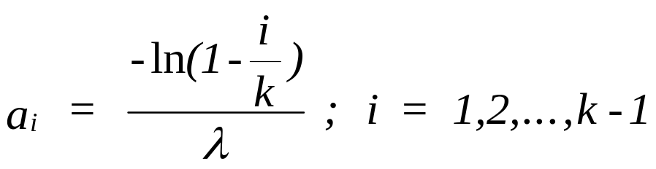
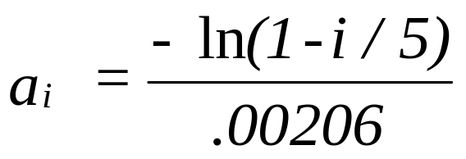
Alternate Approach
letting k = 5, then p_{i} = 0.2 and E_{i} = 35 (0.2) = 7 and
Chapter 16
Notes:
Rather than fixing the end points of the intervals in which the observations are grouped, the end points can be found so that each interval has the same specified expected cell count. First specify k, the number of intervals to be used. Then the probability of a failure in each interval will be 1/k and the expected number of failures in each interval will be n/k where n is the sample size (number at risk). The interval end points, a_{i}, are found using the CDF of the hypothesized probability distribution where F(a_{i}) = i/k.

Slide 9
Alternate Approach
CELL LOWER UPPER OBSERVED EXPECTED (O-E)^2/E
1 0.00 108.3 5.00 7.00 .57
2 108.36 247.8 9.00 7.00 .57
3 247.8 444.6 9.00 7.00 .57
4 444.6 780.8 6.00 7.00 .14
5 780.8 inf 6.00 7.00 .14
= 1.99
Since _{crit,.10,3} = 6.25, we accept H₀.
Chapter 16
Notes:
Shown is the previous example using the alternate approach. With this approach, k can be determined such that n/k >= 5. Since k must always be greater than one plus the number of estimated parameters, the sample size n has a lower bound of 5 x (number of parameters + 2).

Slide 10
Weibull Example
  The following 35 failure times in days were observed from
  50 light bulbs placed on test. The test was terminated at the
  35th failure (Type II Censoring). The failures are believed to
  follow a Weibull distribution.
1.3 7.3 7.8 13.3 13.9
19.4 19.7 22.3 22.8 26.7
29.7 30.2 31.9 32.2 33
36.8 37 41.7 46.7 50.4
51.4 60 61.3 61.4 65.6
65.8 72.6 78.4 100.4 110.6
111.4 118.2 119.4 132.1 139.7
The MLE's were computed using Equation (15-11) and (15-12)
with estimated beta = 1.032 and theta = 112.9 days.
Chapter 16
Notes:
When right censored data is present, the observed count in the last cell will contained all of the censored units since their actual failure times are unknown but must occur after the last recorded failure time. For that reason, it is good practice to place all of the censored units in a cell containing no failure counts.

Slide 11
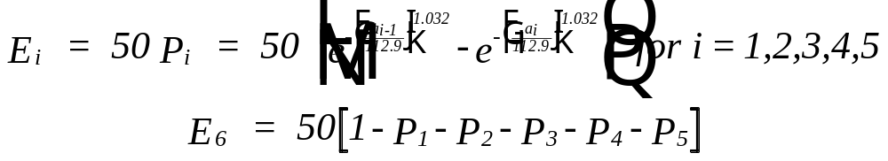


Weibull Example
The failure times are then grouped into 5 classes of width
28 [(139.7 - 1.3)/5 = 27.68]. Therefore a₁=28, a₂=56,
a₃=84, a₄=112, and a₅=140. The remaining failure times, are
placed in the 6th class. The expected cell counts are
computed in the following manner:
H₀: Failure times are Weibull with =1.03, =112.9 days
H₁: Failure times are not Weibull with =1.03, =112.9
Chapter 16
Notes:
Continuing with the Weibull example. Remember that the Chi-square statistic is based upon using MLEs for the hypothesized distribution.

Slide 12

Weibull Example
UPPER BND OBSERVED PROB EXPECTED (O-E)^2/E
28 10 .2116768 10.58384 .0322
56 11 .1730505 8.652523 .6368834
84 7 .1369408 6.847042 .0034
112 3 .1074198 5.370988 1.046657
140 4 .0838523 4.192615 .0088
INFINITY 15 .2870598 14.35299 .0292
= 1.7572
degrees of freedom = 6 - 1 - 2 = 3
Chapter 16
Notes:
Two cells are combined following the rule of thumb requiring the expected cell counts to be at least 5.

Slide 13
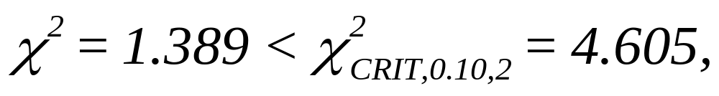
Weibull Example
UPPER BND OBSERVED PROB EXPECTED (O-E)^2/E
28 10 .2116768 10.58384 .0322
56 11 .1730505 8.652523 .6368834
84 7 .1369408 6.847042 .0034
140 7 .1912721 9.563602 .6871948
INFINITY 15 .2870598 14.35299 .0292
= 1.388868
degrees of freedom = 5 - 1 - 2 = 2
cannot reject H₀
Chapter 16
Notes:
The computed statistic is then compared to a critical table value.

Slide 14
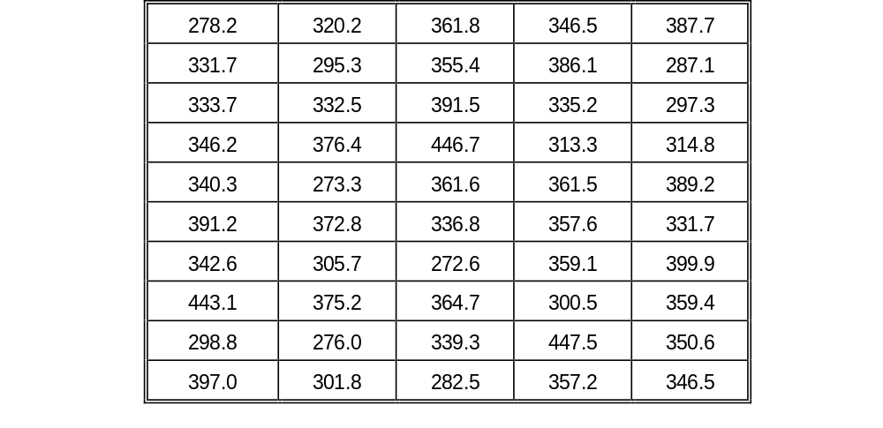
A Normal Example
Fifty bearings were placed on an accelerated stress test until wear
out failure was observed (complete data). It is believed wear out is
normally distributed. Failure times are in (accelerated) operating hr.
The sample mean (MLE) is 345.5 and the sample std dev (MLE) is 43.6.
Chapter 16
Notes:
A third example is shown. This time fitting a normal distribution with complete data.

Slide 15
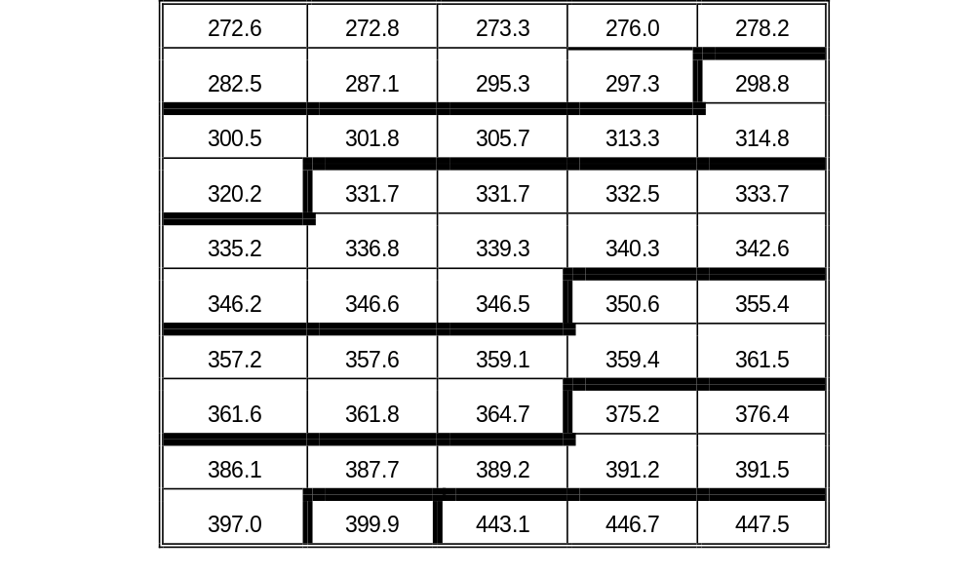


A Normal Example
H₀: Failures are normal with = 345.5, = 43.6
H₁: Failures are not normal with = 345.5, = 43.6
Chapter 16
Notes:
Data is group into 7 intervals of approximately the same width. There is no requirement that each cell have the same width. In fact, different Chi-square values can be computed depending upon how the intervals are constructed. Do you find this disconcerting?

Slide 16
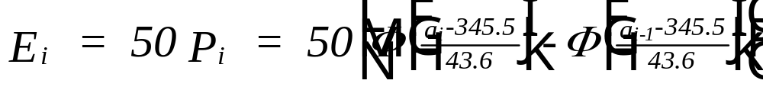
A Normal Example
UPPER BND OBSERVED PROB EXPECTED (O-E)^2/E
298 9 .1378 6.8915 .6451
322 7 .1567 7.8370 .0894
347 12 .2174 10.8685 .11878
372 10 .2171 10.855 .0673
397 8 .1519 7.5965 .0214
422 1 .0789 3.947 2.2004
448 3 .0307 1.50335 1.4024
INFINITY 0 .0094 . .4700 .4700
= 5.33509
Chapter 16
Notes:
Again, cells are combined to increase the expected cell counts.

Slide 17
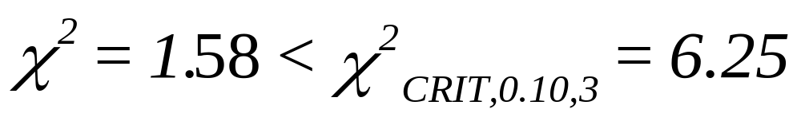
A Normal Example
UPPER BND OBSERVED PROB EXPECTED (O-E)^2/E
298 9 .1378 6.8915 .6451
322 7 .1567 7.8370 .0894
347 12 .2174 10.8685 .11878
372 10 .2171 10.855 .0673
397 8 .1519 7.5965 .0214
INFINITY 4 .1190 5.9500 .6391
= 1.58
df = 6 - 1 - 2 = 3
Chapter 16
Notes:
Intuitively, the smaller the Chi-square statistic, the more closely the hypothesized distribution fits the sample data.

Slide 18
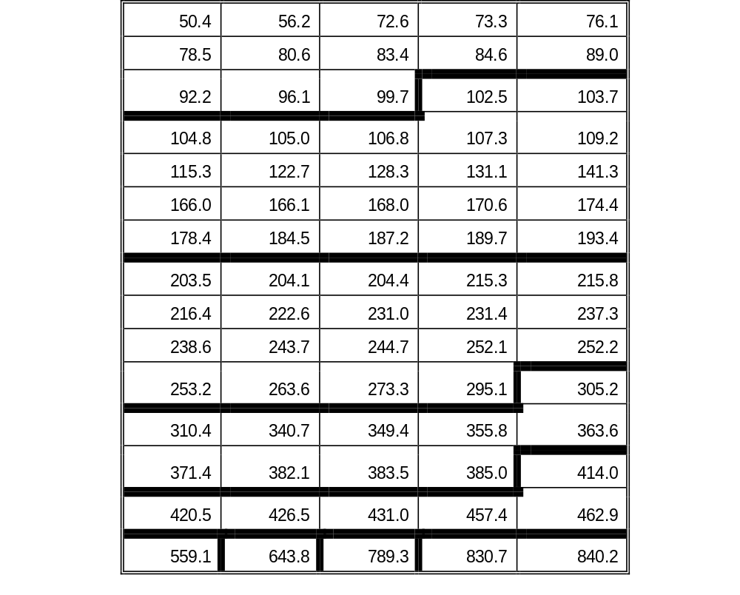
Lognormal
Seventy-five repair times (in minutes) were observed for removing and
replacing a failed component. Repair times are believed to have a lognormal distribution.
H₀: Repair times are lognormal
with t_{med}=199.36 and s=0.654
H₁: Repair times are not lognormal
with t_{med}=199.36 and s=0.654
Chapter 16
Notes:
For the lognormal example, it is assumed that repair times have been collected. The approach is no different than it is with failure times.

Slide 19
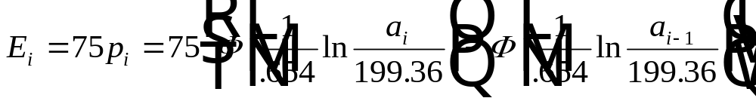
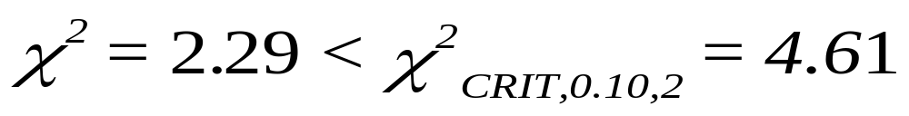
Lognormal
UPPER BND OBSERVED PROB EXPECTED (O-E)^2/E
100 13 .1469 11.0123 .3588
200 22 .3731 27.9810 1.2785
300 19 .2125 15.9323 .5907
400 10 .12341 9.2295 .0643
INFINITY 11 .1446 10.8427 .0023
= 2.29
degrees of freedom = 5 - 1 - 2 = 2
Chapter 16
Notes:
In this example, the lognormal is an acceptable fit to the data. We would conclude, that there is evidence to reject the lognormal distribution.

Slide 20

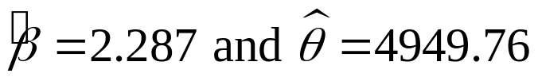
Chi-Square Test for Singly Censored Data
EXAMPLE 16.5. The following failure times in cycles resulted from submitting 35 mechanical switches to an accelerated life test terminating at failure or at 6000 cycles:
450 1479 1581 1750 1825 2116 2441 2545 2609 2724 2732 3442 3624 3745 3831 3839 3879 4641 4940 4989 5050 5217 5596 5601 5654 5736 5851 5869 5911
The Weibull distribution with MLE’s was subjected to the chi-square test with the data grouped into 7 cells. The 6 censored units were counted in the last cell.
Chapter 16

Slide 21
Chi-Square Test for Singly Censored Data
Cell | Upper Bound | Observed | Probability | Expected | (O-E)²/E
1 | 1000 | 1 | 0.0255 | 0.8912 | 0.0133
2 | 2000 | 4 | 0.0928 | 3.2485 | 0.1739
3 | 3000 | 6 | 0.1542 | 5.3986 | 0.0670
4 | 4000 | 6 | 0.1865 | 6.5265 | 0.0425
5 | 5000 | 3 | 0.1816 | 6.3568 | 1.7726
6 | 6000 | 9 | 0.1477 | 5.1706 | 2.8361
7 | ∞ | 6 | 0.2117 | 7.4078 | 0.2676
The computed Χ² = 5.1729 < critical Χ² = 7.78 with 4 degrees of freedom at the 10% level.
Therefore, the Weibull distribution cannot be rejected.
Chapter 16

Slide 22

Goodness of Fit Tests for Specific Distributions
Bartlett’s Test for exponential
Mann’s Test for the Weibull
Kolmogorov-Smirnov Test for normal/lognormal
Trend & GOF for power law process model
Chapter 16

Slide 23
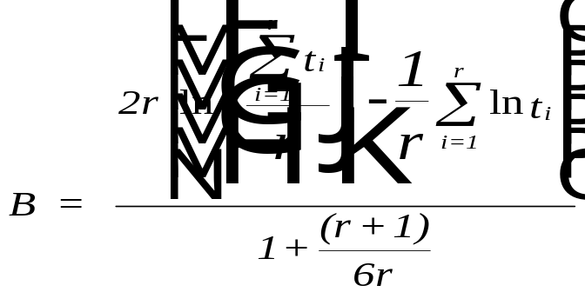
Bartlett’s Test for Exponential
H₀: Failures times are exponential
H₁: Failure times are not exponential
where: t_{i} = time of failure of ith unit
r = number of failures
The test statistic, B, under the null hypothesis, has a
chi-squared distribution with r-1 degrees of freedom.
Chapter 16
Notes:
The Chi-square GOF is a general test that can be applied to any probability distribution. Because it is general,the power of the test may be weak. The power is the probability of correctly rejecting the null hypothesis. The power can always be increased by increasing the sample size. However, for small sample sizes, more powerful tests can be used. These are tests specifically designed for a certain probability distribution. The Bartlett test is designed for fitting an exponential distribution. This test does not require estimating the parameter of the exponential. The test statistic here also has a Chi-square distribution.

Slide 24
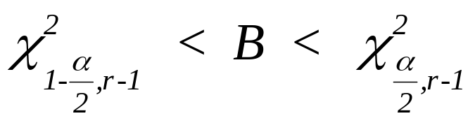
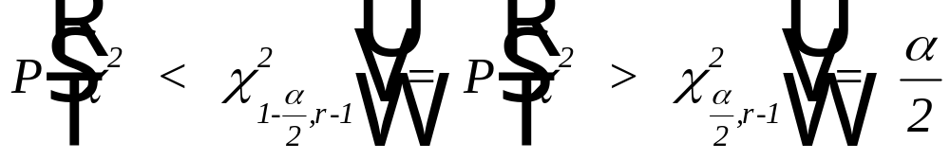
Bartlett’s Test for Exponential
If
do not reject H₀
where
Thirty units were placed on test until 20 failures were observed.
The following failure times were obtained in accelerated test hrs:
50.1 20.9 31.1 96.5 36.3 99.1 42.6 84.9 6.2 32.0
30.4 87.7 14.2 4.6 2.5 1.8 11.5 84.6 88.6 10.7
Chapter 16
Notes:
An example of Bartlett’s test is shown. Rejection of the exponential occurs if the test statistic falls below a lower critical value or above an upper critical value.

Slide 25
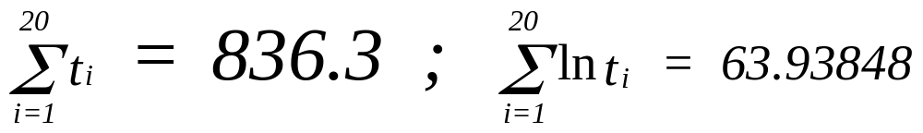
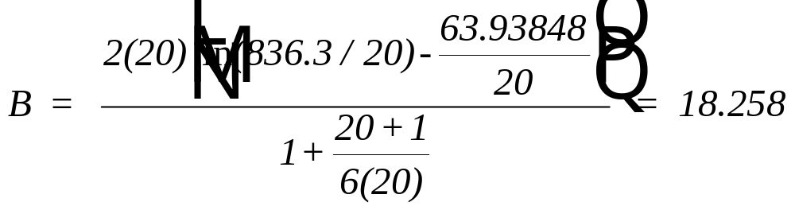
Bartlett’s Test for Exponential
with r = 20:
since
cannot reject H₀
Chapter 16
Notes:
Use the course software and this same data set. Do you get the same result?

Slide 26
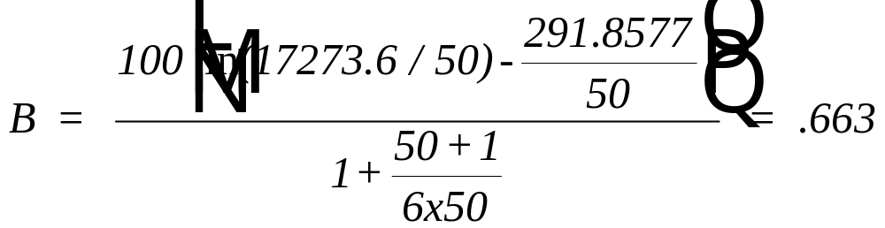
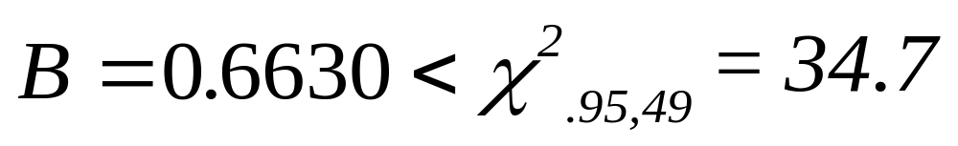
Bartlett’s Test (normal data)
Reject the exponential distribution!
Chapter 16
Notes:
Using normal data from the textbook, Bartlett’s test easily rejects the hypothesis that the sample came from an exponential distribution.

Slide 27
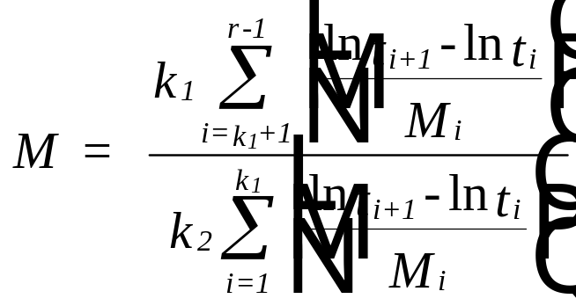
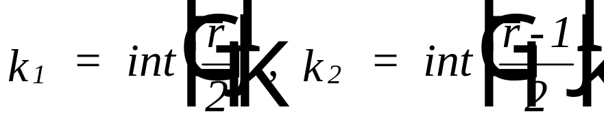
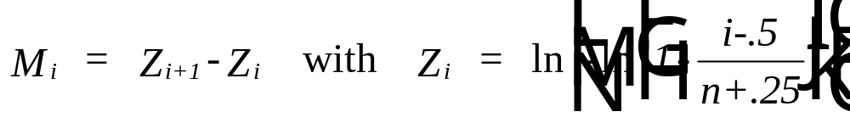
Mann’s Test for the Weibull
H₀: The failure times are Weibull
H₁: The failure times are not Weibull
If M > F_{crit}, then H₁ is accepted.
Values for F_{crit} may be obtained from tables of the F-distribution where:
df for the numerator = 2k₂,
df for the denominator = 2k₁.
Chapter 16
Notes:
Not to be outdone by Bartlett, Mann has developed a specific GOF test for the Weibull. In this case, the test statistic has an F distribution. Again, it is not necessary to estimate the parameters of the Weibull to use this test. The computations can be a little tedious if done by hand?

Slide 28
Mann’s Test for the Weibull
from Ex. 16.2:
t ln t_{i} M_{i} n t_{i+1} - ln t_{i} (ln t_{i+1}-ln t_{i})/M_{i}
1.3 .2623642 1.108726 1.72551 1.5563
7.3 1.987874 .5211189 6.624937E-02 .1271291
7.8 2.054124 .3469455 .5336404 1.53811
13.3 2.587764 .2619765 4.412461E-02 .1684296
13.9 2.631889 .2115278 .3333843 1.576078
19.4 2.965273 .1781142 .01534557 .086155828
19.7 2.980619 .1543733 .1239684 .8030428
22.3 3.104587 .1366559 2.217364E-02 .1622589
22.8 3.126761 .1229487 .157903 1.2843
26.7 3.284664 .1120471 .1064837 .9503478
29.7 3.391147 .1031873 1.669478E-02 .161791
30.2 3.407842 9.586036E-02 5.476403E-02 .5712897
Therefore n = 50, r = 35, k₁ = k₂ = 17 and numerator = 352.3682
and denominator = 211.7246. M = 1.664 with 34 df for both the
numerator and denominator.
Since M=1.664 < F_{CRIT, .05, 34, 34}, then H₀ is accepted.
Chapter 16
Notes:
Some very good failure times are tested against the Weibull using the Mann test.

Slide 29
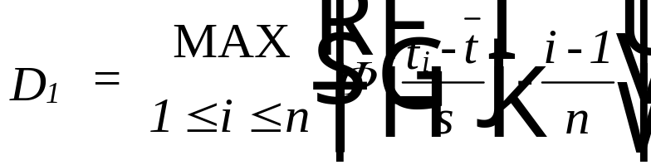
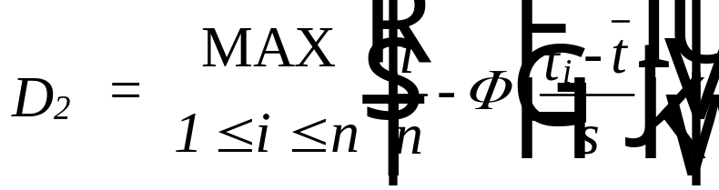
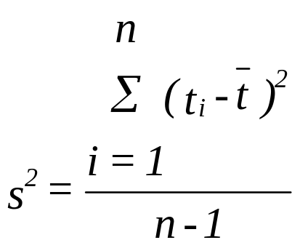
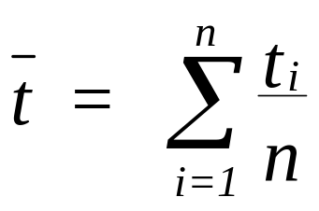
Kolmogorov-Smirnov Test
Complete
Samples
Only!
H₀: The failure times are normal
H₁: The failure times are not normal
The test statistic is D_{n} = max{ D₁, D₂ }, where
If D_{n} < D_{crit}, then accept H₀
If D_{n} >= D_{crit}, then accept H₁
The values for D_{crit} may be found in the Appendix
Chapter 16
Notes:
The K-S test is a GOF for the normal that can also be applied to the lognormal distribution. The test statistic is the maximum distance between the hypothesized CDF and an empirical CDF. This statistic is then compared to a value in a table of critical values.

Slide 30
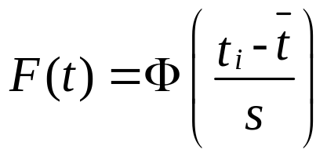
The Geometry of the K-S Test
3/n
2/n
1/n
D₂
D₁
T₁ t₂ t₃
Chapter 16

Slide 31
Kolmogorov-Smirnov Test
The following fifteen observations represent a sample of the repair times
in hours of a complex piece of machinery. Test the hypothesis that the
repair time is normal.
61.6 70.0 78.4 75.3 83.5
72.3 65.1 77.1 83.2 63.4
72.7 72.5 84.3 73.0 65.5
Rank ordering the data and computing the MLEs:
61.6 63.4 65.1 65.5 70.0
72.3 72.5 72.7 73.0 75.3
77.1 78.4 83.2 83.5 84.3
SAMPLE MEAN = 73.2 and SAMPLE STD DEV = 7.041221
Chapter 16
Notes:
An excellent example of the K-S test.

Slide 32
H₀: Repair time is normal with mean = 73.2 and std dev =7.041
H₁: Repair time is not normal with mean =73.2 and std dev =7.041
(I-1)/N I/N CUM. PROB D1(I) D2(I)
0 6.666667E-02 .0495 .0495 0172
6.666667E-02 .1333333 .0823 .0156 .0511
.1333333 .2 .1251 -.0083 .0749
.2 .2666667 .1379 -.0621 .1288
.2666667 .3333334 .3264 .0597 .0070
.3333334 .4 .4483 .1149 -.0483
.4 .4666667 .4602 .0602 .0065
.4666667 .5333334 .4721 .0054 .0612
.5333334 .6 .4880 -.0453 .1120
.6 .6666667 .6179 .0179 .0488
.6666667 .7333334 .7088 .0422 .0245
.7333334 .8 .7704 .0370 .0297
.8 .8666667 .9222 .12222 -.0555
.8666667 .9333333 .9279 .0612 .0055
.9333333 1 .9430 .0096 .0570
MAX D₁ .1183821
MAX D₂ .1208173
K-S TEST STAT .1208173
SAMPLE SIZE 15
Since D₁₅ = 0.1208 < D_{CRIT,10} =.201, then H₀ is accepted.
Chapter 16
Notes:
The example continued.

Slide 33
Kolmogorov-Smirnov Test - Lognormal
Given failure times t'₁, t'₂, ..., t'_{n}, then set t_{i} = ln t'_{i} and use
Equations (16-4) where tbar and s are the sample mean and sample
standard deviation of t₁, t₂, ..., t_{n} respectively.
The time to failure of hose assemblies, due to structural fatigue and chemical breakdown, is believed to have a lognormal distribution. The following 25 failure times were obtained from environmental stress testing (complete data).
240.5 511.8 1083.4 821.3 1725.4 629.4 326.9 964.8 1677.8 282.3
652.3 639.2 1847.8 670.8 338.8 818.1 1407.5 4991.0 452.0 464.9
734.9 220.2 1078.1 1077.3 1773.0
H₀: Failure times are lognormal with t_{MED}=765.426 and s=0.725
H₁: Failure times are not lognormal with t_{MED}=765.426 and s=0.725
Since D₂₅=0.0756 < _{DCRIT, .10} = 0.165, H₀ is accepted
Chapter 16
Notes:
Now let’s try to fit a sample of failure times to a lognormal using the K-S test.

Slide 34

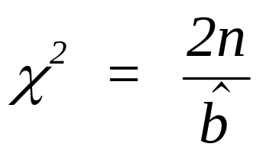

Power-Law Process Model (AMSAA)
Trend Test
(t) = abt^{b-1}, the hypotheses tested are:
H₀: The intensity function is constant (b = 1)
H₁: The intensity function is not constant (b = 1)
If b < 1, then system is improving (reliability growth)
if b > 1, then system is deteriorating (minimal repair)
where is the MLE for the
AMSAA model
Test statistic:
Under the null hypothesis, the test statistic has a
chi-square distribution with 2N degrees of freedom (df) for
Type I testing and 2(N-1) df for Type II testing.
The null hypothesis is rejected if χ² < χ²_{crit,1-a/2} or χ² > χ²_{crit,a/2}
Chapter 16
Notes:
The null hypothesis for the above trend test is that the data came from a Poisson process having a constant intensity function. A rejection of the null hypothesis allows either an increasing or decreasing failure trend to be assumed. The test statistic has a Chi-square distribution.

Slide 35
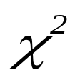
Trend Test - Example 14-4
N = 15 and the MLE for b = .28685.
Therefore, = 30 / .28685 = 104.58 has a chi-square
distribution with 28 degrees of freedom.
_{crit,.95} = 16.928 and _{crit,.05} = 41.337.
Since = 104.58 > 41.337, then there
is a significant trend present. Since
the estimate for b < 1, there is
significant growth.
Chapter 16
Notes:
The trend test in action.

Slide 36
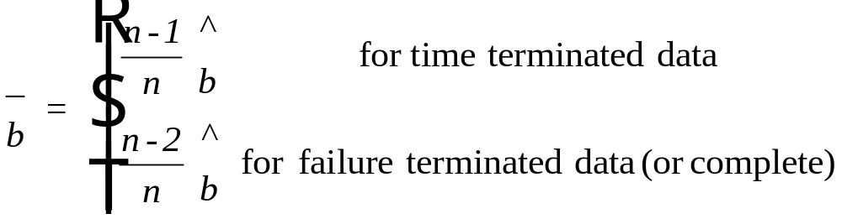
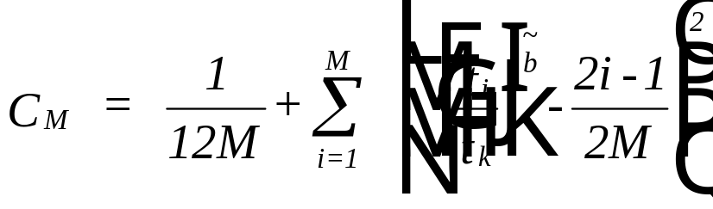
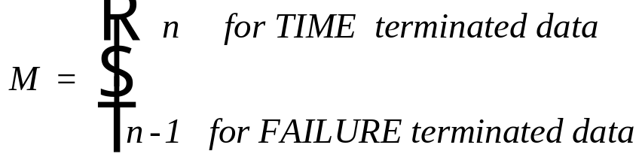
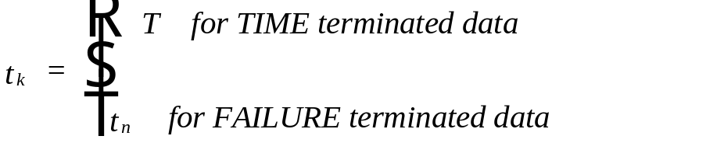
Goodness-of-Fit Test
H₀: A nonhomogeneous Poisson process with intensity abt^{b-1}
H₁: The above process does not describe the data.
find an unbiased
estimate for b:
test
statistic:
T = total cumulative test time or total system observed time under time
terminated data. Critical values are found in the Appendix.
Chapter 16
Notes:
This is the Cramer-von Mises GOF test. It allows for rejection of a nonhomogeneous Poisson process whenever the test statistic, Cm, exceeds the table critical value. While the trend test allows us to reject a constant intensity function (i.e. the exponential), the Cramer-von Mises tests then allows us to accept the Nonhomogeneous Poisson process.

Slide 37
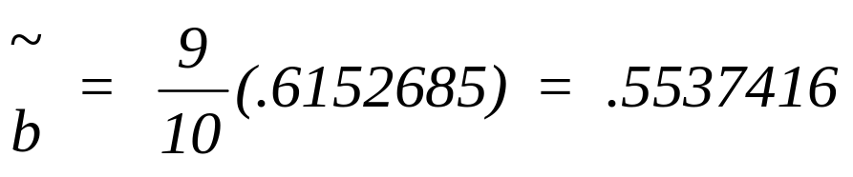
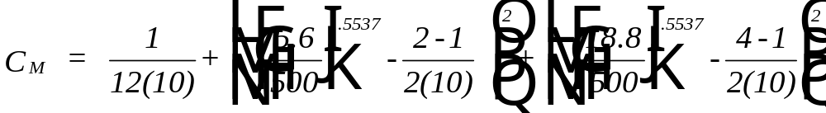
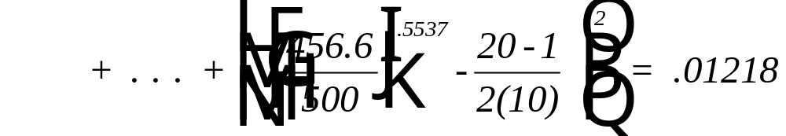
GOF Test - Example 16.11 (14.3)
M = 10
C_{crit, .10} = .167.
Since C_{M} < .167 then H₀ is accepted.
Chapter 16
Notes:
Execute the software against the same data set.

Slide 38
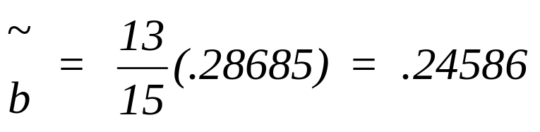
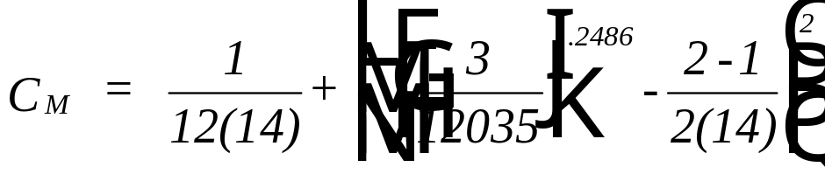
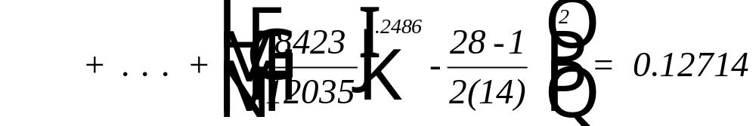
GOF Test - Example 16.12 (14.4)
M = 14
C_{crit, .10} = .169.
Since C_{M} < .169, accept H₀.
Chapter 16
Notes:
A second example of the Cramer-von Mises test.

Slide 39
Power-Law Process - Minimal Repair Example 16.13
The following failure times in working days were recorded on
a numerical control (NC) machine (that has been operating for
916 days):
211, 287, 345, 456, 567, 631, 705, 784, 817, 856, 893, 916
The Chi-square statistic for the trend test,
= 24 / 2.076 = 11.56 < _{crit,.95} = 12.338 based on 22 df.
Therefore the hypothesis of a significant trend is accepted.
Since the estimate of b > 1, the machine is deteriorating.
Chapter 16
Notes:
Both the trend test and the GOF test can be applied to analyze failure data under a minimal repair concept.

Slide 40
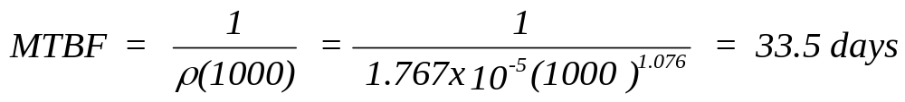
Power-Law Process - Minimal Repair Example 16.13
The goodness-of-fit test provided C_{M} = .0239 < .172 -
the critical value at 10 percent level of significance.
As a result, the computed intensity function was accepted.
After four years of usage (approximately 1000 working days),
the MTBF of the machine is estimated to be:
Chapter 16
Notes:
The completion of the example.

Slide 41
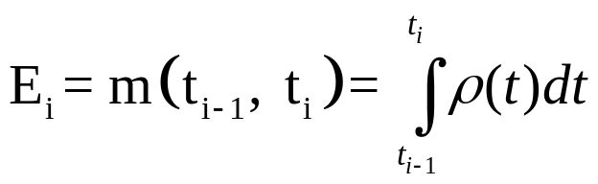
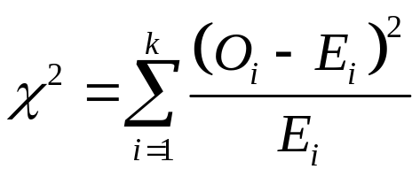
GOF for grouped data
With grouped data as described in 14.4.2, the chi-square goodness-of-fit test can also be used to test the following hypotheses:
H₀: The nonhomogeneous Poisson Process with intensity ρ(t) describes the data
H₁: The above process does not describes the data
Letting O_{i} = n_{i} = the observed count in the interval (t­_{i-1}, t_{i}) and
Then has a chi-square distribution with
k-2 degrees of freedom
Chapter 16

Slide 42
Chapter 16
Statistical Tests
Chi-Square Test
Bartlett’s Test
Mann’s test
Kolmogorov-Smirnov Test
Tests for the Power-Law Process Model
Chapter 16
Notes:
In the previous Chapter, procedures for identifying candidate failure or repair distributions were discussed along with methods for estimating their parameters. The paradigm is completed with the introduction of statistical tests of the hypothesis that these failure (repair) times came from a specified distribution. Such tests are referred to as goodness-of-fit tests.

